Slide 1
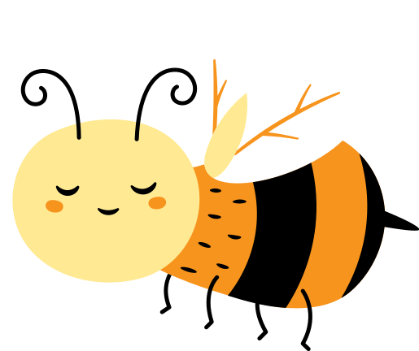
Bee ‘Yourself’

Slide 2
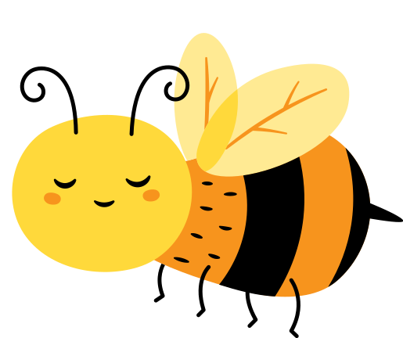
BEE ‘Yourself’
Who am I?

Slide 3
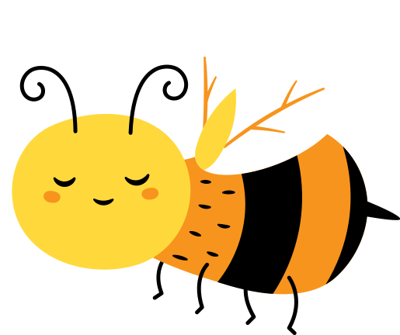
Maulaya Hasan bin Nooh ^{QR}

Slide 4
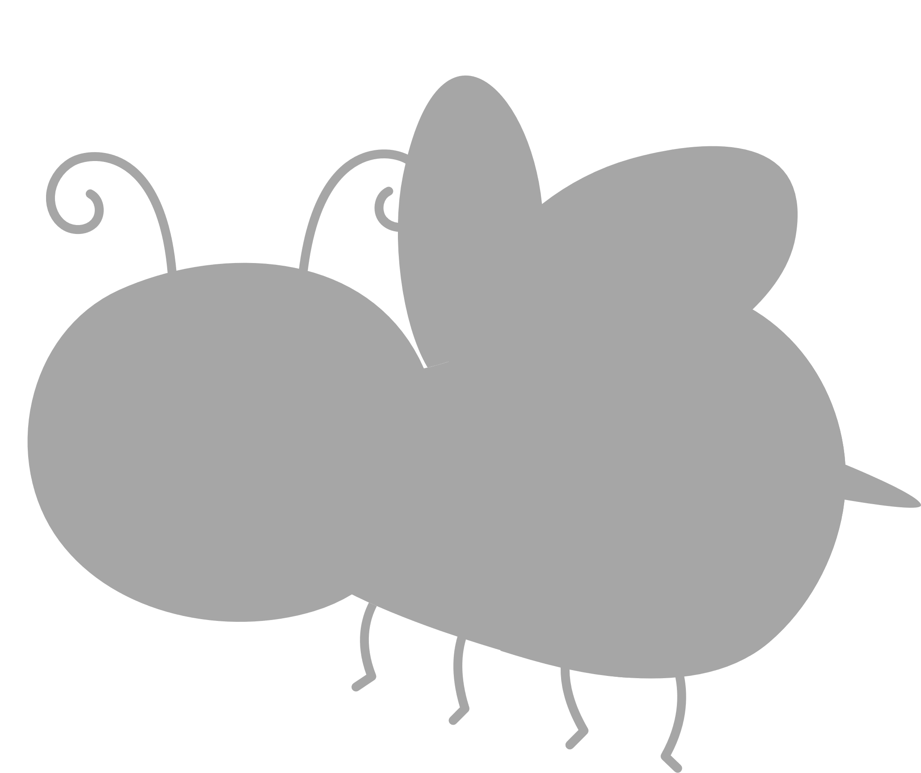
I am Unique!
& BEE-utiful

Slide 5
Why?

Slide 7
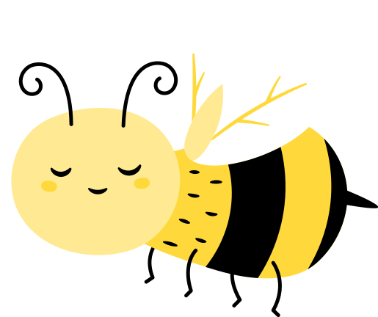
كل الثمرات

Slide 8
TOP

Slide 9
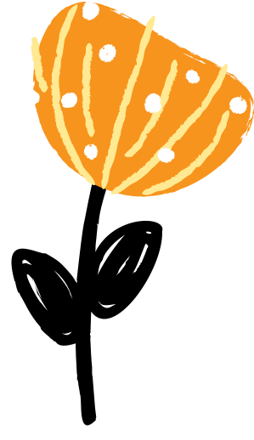
Which flowers are real ?

Slide 10
BEES
Humans….

Slide 11
THIS
THIS
OR

Slide 12
Always follow our QUEEN

Slide 13
MOULA ^{TUS}
MUMINEEN
KHIDMAT
BENEFIT
MY HIVE
GIVING BACK

Slide 14
BEES
Resource Page
[Text]
[ Copy ]

