Slide 1
Mahad
al-Hasanaat
al-Burhaniyyah
Notes:
Event Marketing and Invitation - Banners and flyers to be hanged in Masjid periphery/ Markaz/ Mawaid and Handouts to be distributed amongst mumineen to create awareness about the program. An invitation for this program should be sent to all parents and children at least 7 days prior to the date of the program.
RSVP can be taken from the parents.
Venue - A special play area (with different toys, slides, swings, etc) should be set up for children in or near the venue of the program. Friendly, playful volunteers can be selected to take care of them during the program.
About the presentation - The slides of this are designed to maximise interaction with the audience, however you can make changes as per the necessity and situation of your mauze. Note: This presentation also contains a few files in .gif format. You will not be able to see or display it’s animation in a .pdf format file.
A small kit to be distributed amongst the audience upon entrance which will contain the following:
Know your child activity sheet.
Nature v/s Nurture flash card.
Dates and a few dry fruits.
28 things to take care of for farzando aged +3

Slide 2
المقدمة
Introduction
www.talabulilm.com
Notes:
Welcome the audience and give them a brief outline of the program.
Tilawat al-Quran al-Kareem
Tilawat al-Marasi wal Nasihat
Introduction
SEGMENT 1: How well do you know your child?
Understanding the four major areas of development.
SEGMENT 2: Nature v/s Nurture
The four centres of learning
SEGMENT 3: A few techniques, tips and Key Strategies for nurturing

Slide 3
تلاوة القراْن الكريم
www.talabulilm.com
Notes:
Sagla farzando saathe mili ne tilawat kari sake che.

Slide 4
يا سيــــــد الشظظداء خامس اهل الكساء عـــــــلى عظيم بلاء نــــــــــــالك في كربلاء طول الزمان بــــكائي والظظفـــــــــــتا يا حسينا يا سيد الشظظداء
www.talabulilm.com
Notes:
Sagla saathe mili ne tilawat kari sake che.

Slide 5
فلك الحسين بكربلاء ملك الحسين بكربلاء نسك الحسين بكربلاء مسك الحسين بكربلاء ابكيك مولاي الحسين افديك مولاي الحسين مولاي مولاي الحسين
www.talabulilm.com
Notes:
Sagla saathe mili ne tilawat kari sake che.

Slide 6
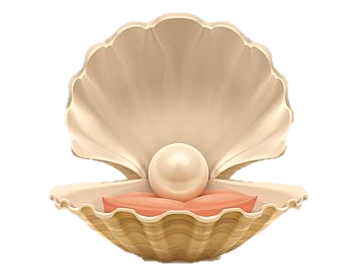
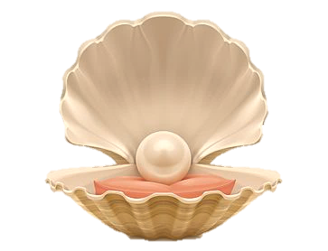
النصيحة عــــــــــــــــــــلم نا موتي جرٌو ثثرٌهــــــــــــوا ني هضض نه كرو اثثنـــــــــــــــــــــــا ملا سي درو كيكا بهائي جلدي ثثرٌهو ادنى تهئي رهجو غـــــــلام شــــــــــــــــــكر نا كظظجو كلام سجده دئي كرجو سلام كيكا بهائي جلدي ثثرٌهو
www.talabulilm.com
Notes:
Sagla saathe mili ne tilawat kari sake che.

Slide 7
www.talabulilm.com
Notes:
Why are we here?
Logo si jawaab talab kari sakai che.
Discuss the motive of this program and how will the program benefit the audience.

Slide 8
امير المؤمنين مولانا علي^{ص ع}
www.talabulilm.com
Notes:
Ameer al Mumineen SA aapna farzand Imam Hasan AS ne ghani wasiyato karta. Apne ye wasiyato ni barakaat Moula TUS alag alag mawaiz nooraniyah ma bayan kari pohchawi rahya che.

Slide 9
مولانا علي ابن ابيطالب ^{ع م} فرماوسس ؛:
حرِّض بَنِيكَ عَلى الآدَابِ في الصِغَر
كَيمـَا تَقِرُّ بِهِ عَينَاكَ في الكِبـَر
تميطط تمارا فرزندو نسس ححهوضضثثن ما} اهوا اْداب سكهاؤ كھ يھ مهوضضا تهائي تو تماري اْنكهو اهما تهندٌي تهائي،
www.talabulilm.com
Notes:
Apna Farzando apna gharo ma ye Moula TUS ni Amanat che.
Apne yaha ye amanat ne pehchanvane aaya che.
Ehni tarbiyat kem karwi ehna waste bhi Moula TUS apne hidayat ape che, apne sikhawe che.
Ke chotpan sij sikhawjo. Adabdaar karjo.

Slide 10
مولانا علي ابن ابيطالب ^{ع م} فرماوسس ؛:
و اِنَّـمـَا مَثَلُ الآدَابِ تَـجمَعُهَا في عُنفُوَانِ الصِّبَا كَـالنَّقشِ في الحـَجَر
بححثثن نا شروع ما جو فرزند كوئي اْداب سيكهسس ؛ تو يھ ثثتهر ما كوتروا ني مثل ؛.
www.talabulilm.com

Slide 11
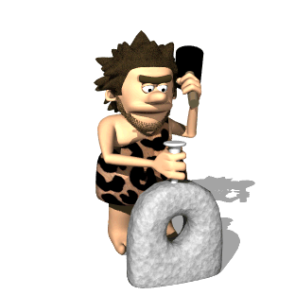
Imbibing good habits in early age
is like inscribing on a stone.
www.talabulilm.com
Notes:
Baaz cheezo sikhawye che, baaz cheezo ye mansi apne dekhi ne sikhi jai che.

Slide 12
0-3 years of age is the most significant age in a child’s brain development
www.talabulilm.com
Notes:
Researchers say that this age is the most significant age in a child’s brain development.

Slide 13
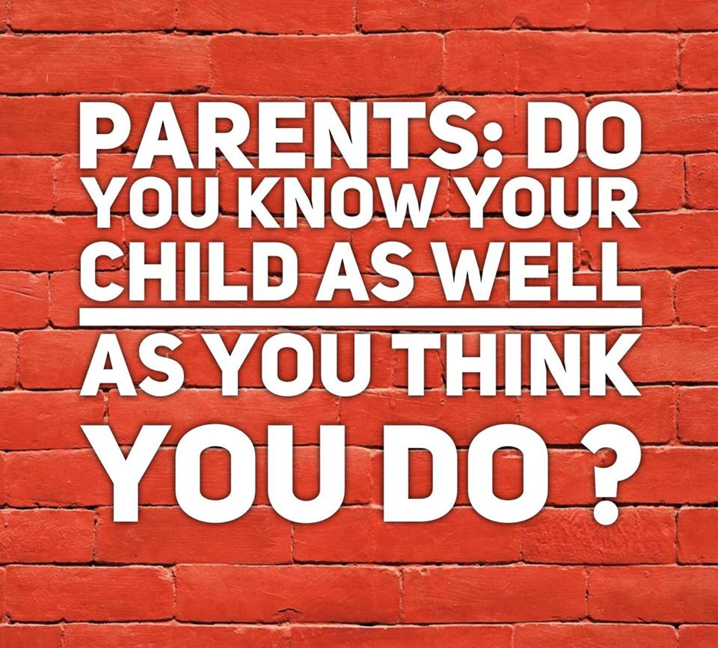
www.talabulilm.com
Notes:
Lets do an activity to understand at what stage or level is our child currently in?

Slide 14
How much do you know your child?
#KnowYourChild
www.talabulilm.com

Slide 15
#KnowYourChild
www.talabulilm.com
Notes:
Print this activity sheet as per the estimated audience count in your mauze and distribute it with other handouts upon entry. (You will require a few volunteers to do so)

Slide 16
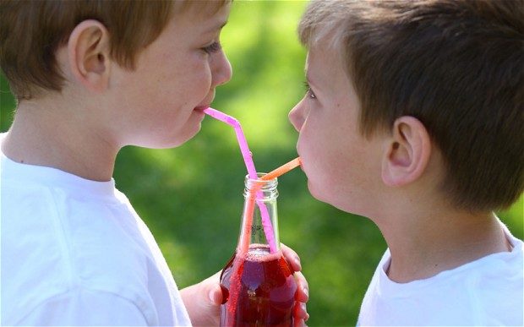
#KnowYourChild
www.talabulilm.com
Notes:
Sharing.
At what age does a child start sharing? No specific but at an early age. (Refer to the video provided with this PPT for more insights)
IMPORTANT NOTE: Every child has his own pace at which he learns. You do not need to panic if your child does not do anything from the following:
If he/ she doesn’t do these things yet, he/she will as they grow.

Slide 17
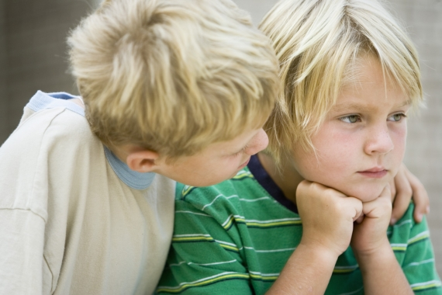
#KnowYourChild
www.talabulilm.com
Notes:
Caring.

Slide 18
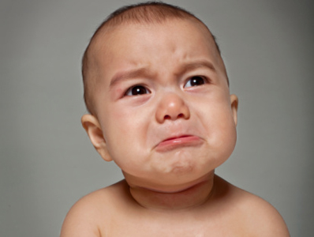
#KnowYourChild
www.talabulilm.com
Notes:
Cries easily.

Slide 19
#KnowYourChild
www.talabulilm.com
Notes:
Smiles or Laughs.
(Crying, smiling and laughing is an integral part of a child’s development).

Slide 20
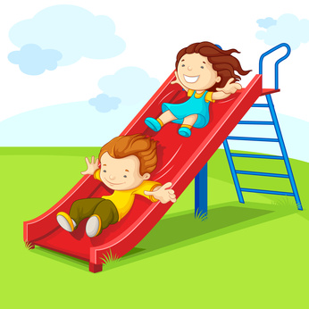
#KnowYourChild
www.talabulilm.com
Notes:
Sliding.

Slide 21
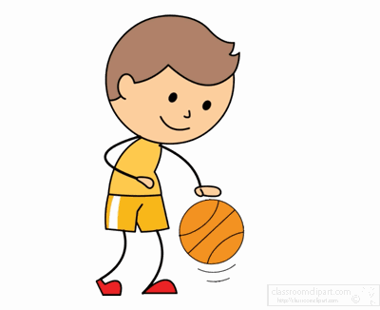
#KnowYourChild
www.talabulilm.com
Notes:
Bouncing a ball.

Slide 22
#KnowYourChild
www.talabulilm.com
Notes:
summer sault.

Slide 23
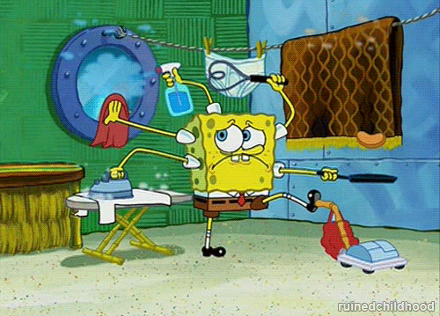
#KnowYourChild
www.talabulilm.com
Notes:
Helping in chores.

Slide 24
#KnowYourChild
www.talabulilm.com
Notes:
Zipping and Unzipping.

Slide 25
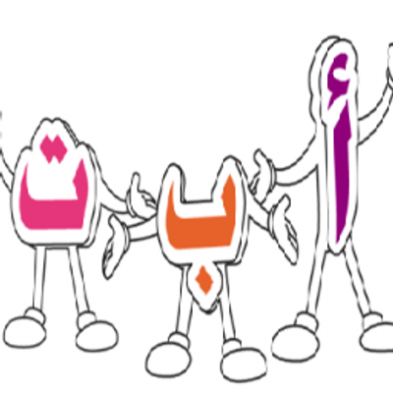
#KnowYourChild
www.talabulilm.com
Notes:
Comfortable in his/her mother tongue.

Slide 26
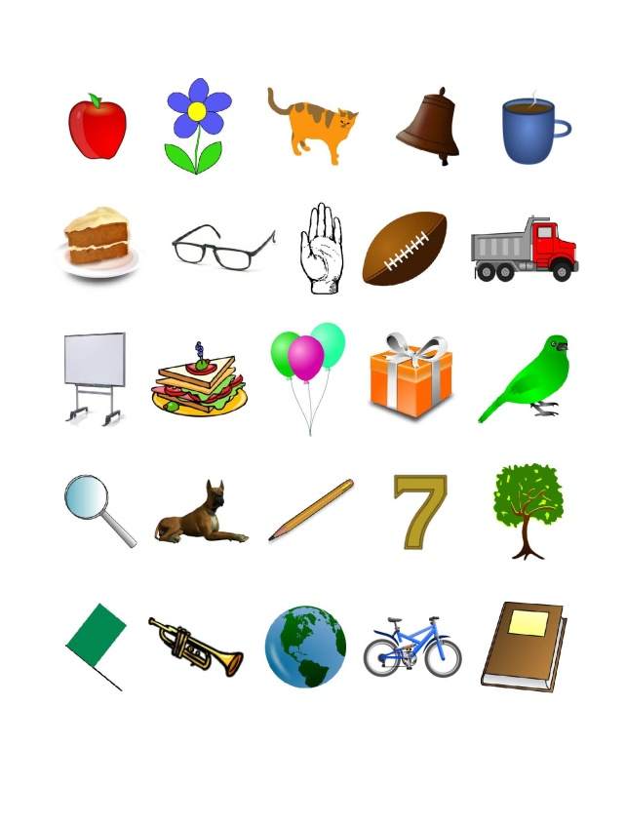
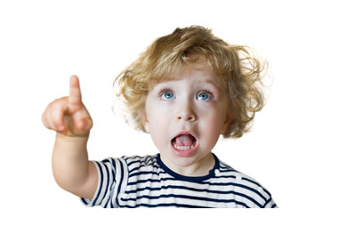
#KnowYourChild
www.talabulilm.com
Notes:
Recognize objects.

Slide 27
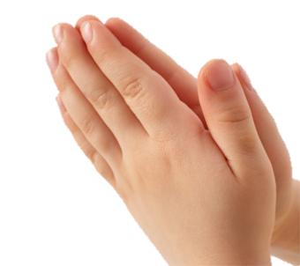
#KnowYourChild
www.talabulilm.com
Notes:
Haath jorwu.

Slide 28
#KnowYourChild
www.talabulilm.com
Notes:
Pays attention.

Slide 29
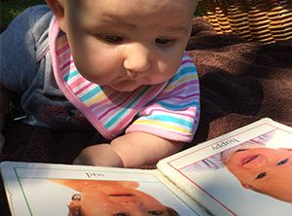
#KnowYourChild
www.talabulilm.com
Notes:
Differentiates and distinguishes between two things.

Slide 30
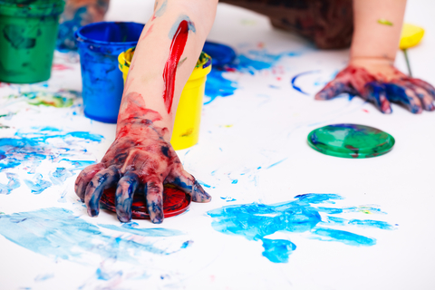
#KnowYourChild
www.talabulilm.com
Notes:
Colouring/ Painting/ Drawing.

Slide 31
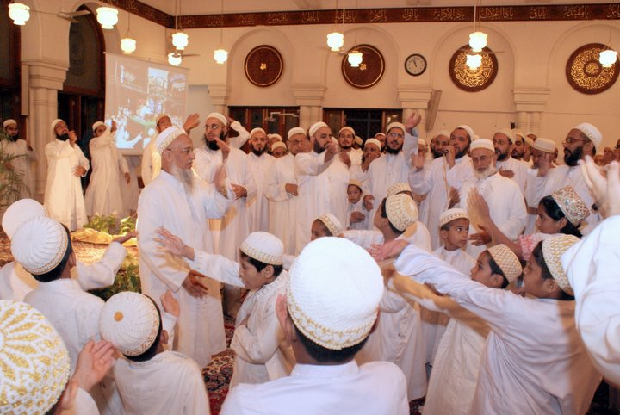
#KnowYourChild
www.talabulilm.com
Notes:
Do matam.

Slide 32
A round of applause for all of us
Notes:
Because we know our child…

Slide 33
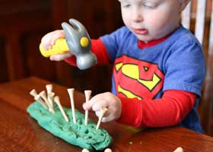
Major Areas of Development
Motor skills
www.talabulilm.com
Notes:
These slides are designed to enhance your interaction with the audience. You can display each slide and ask the audience about what does the slide speaks of.
The activity handout that you have has four sections which are the four areas of development.
Lets try to understand these fours areas better:
Physical
Socio Emotional
Cognitive
Language
We just clapped. What is clapping?
Clapping and Tapping is a part of a childs motor skills development along with the hand and eye coordination.

Slide 34
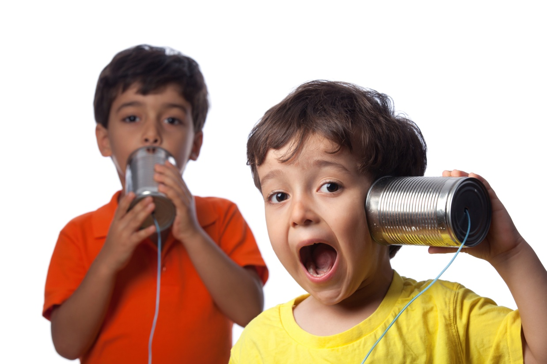
Major Areas of Development
Social skills
www.talabulilm.com
Notes:
Activity:
Do salam with the person to your right and give a smile to the person to your left.
The child starts communicating through different ways…
Smile is a Universal Language. We learn and develop moral & spiritual values in Hazrat Aaliyah TUS.
How would you feel when Maula TUS Smiles at you? Or when you do Qadambosi of Maula TUS?

Slide 35
Major Areas of Development
Cognitive Skills
www.talabulilm.com

Slide 36
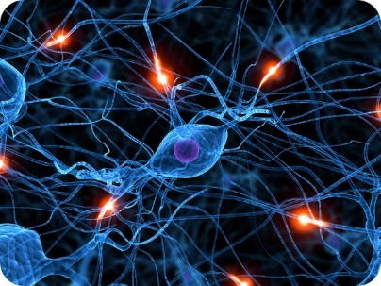
Your child is a Genius 3,000,000,000,000,000 One thousand million million connections by the age of 3yrs.
Cognitive Development
Major Areas of Development
www.talabulilm.com

Slide 37
Major Areas of Development
Language development
www.talabulilm.com
Notes:
Language is also a part of the cognitive development.
Babbling is the beginning of Speech.
Language is to respond, creativity is through imagination.

Slide 38
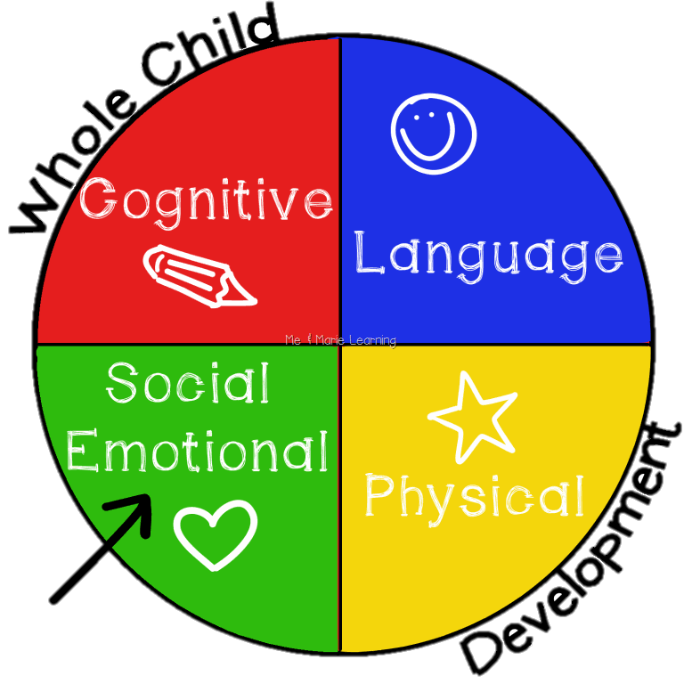
Major Areas of Development
www.talabulilm.com

Slide 39
Reads & Recognizes 900 Words
Major Areas of Development
www.talabulilm.com

Slide 40
Major Areas of Development
www.talabulilm.com

Slide 41
Major Areas of Development
www.talabulilm.com

Slide 42
www.talabulilm.com
Notes:
I am sure all of you had a meaningful time enhancing your awareness about your child.
Let us now focus on ourselves and our actions as parents in shaping the personalities of our children.
Explain nature and nurture.

Slide 43
Nature and Nurture Characteristics Cards Activity
Protocol:-
I will say out loud a Characteristic.
You have to tell me if it is result of NATURE or NURTURE by flashing the Green for Nurture or the Red for Nature
You can only flash ONE card at a time.
Major Areas of Development
www.talabulilm.com
Notes:
We will begin with an activity which will help us understand the connection, correlation between Nature and Nurture.
Print the activity flash cards as per the estimated audience count in your mauze and distribute them with other handouts upon entry. (You will require a few volunteers to do so)

Slide 44
لون العين
www.talabulilm.com
Notes:
Eye Colour.

Slide 45
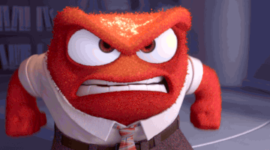
الغضب
www.talabulilm.com
Notes:
Anger.

Slide 46
الصوت
www.talabulilm.com
Notes:
Voice.

Slide 47
القدّ
www.talabulilm.com
Notes:
Height.

Slide 48
الذكاء
www.talabulilm.com
Notes:
Intelligence.

Slide 49
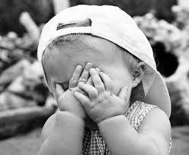
الحياء
www.talabulilm.com
Notes:
Shyness.

Slide 50
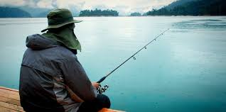
www.talabulilm.com
Notes:
Patience.

Slide 51
COLOR of the SKIN
www.talabulilm.com
Notes:
Skin colour

Slide 52
www.talabulilm.com
Notes:
Creativity & Imagination.

Slide 53
Value Nature
and
Nurture Nature
www.talabulilm.com
Notes:
Conclusion of this activity.
This reinforces that for nurturing/ tarbiyat & good parenting we need to know about the factors which affect and shape the personalities of our children and know them better.
Emm bhi wadeh thai che ke khuda TA ye insaan ne ghani quwat/ potential ane uniqueness aapi che. Ye khuda ni nemat che je no Shukur kai tarah ada thai sakey ke Jem Maula TUS chahe che ye misal apna farzando ni Tarbiyat kari ne

Slide 54
امير المؤمنين مولانا علي ابن ابي طالب ^{ص ع}
www.talabulilm.com
Notes:
Nakhlun Insha Allah - Qambar ni riwayat.

Slide 55
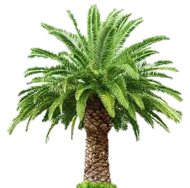
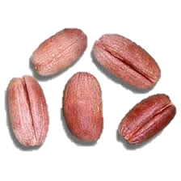
نخل انشاء الله تعالى
A Date Tree Inshallah^{TA}
www.talabulilm.com
Notes:
Nakhl - farmawi ne thalia na Potential (je ehna nature ma che) batayu
Insha Allah - farmawi ne nurturing taraf isharo kido (jo barabar nurture karwa ma awse to)

Slide 56
GOOD PARENTING
in Ikhwanus Safa
impulsiveness
cowardness
Bravery
www.talabulilm.com
Notes:
This qawl mubarak of Saheb al-Rasail is Pivotal in understanding the importance of Tarbiyat and Good Parenting In Islam.
It emphasizes that the onus of good parenting is upon the Parents.

Slide 57
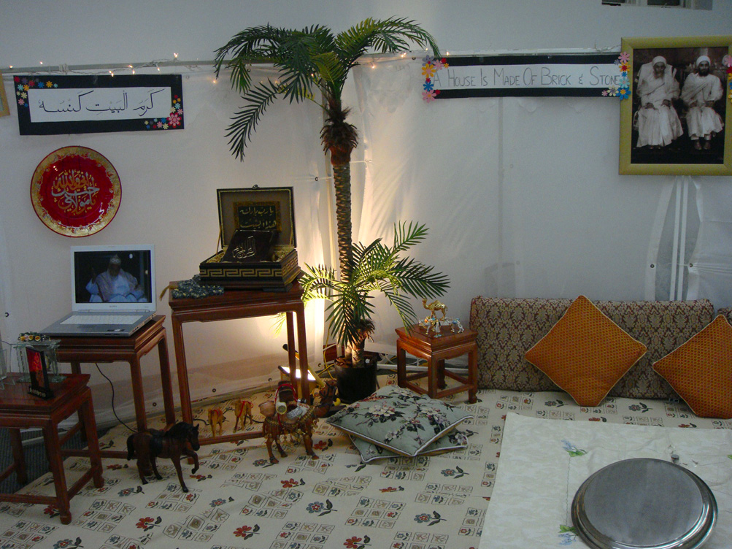
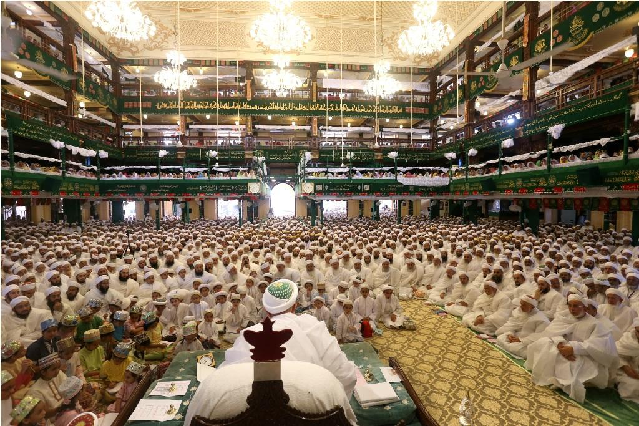
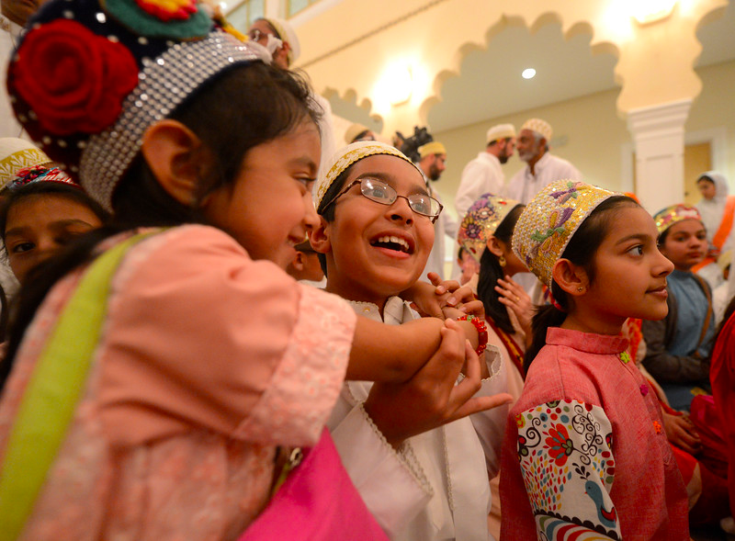
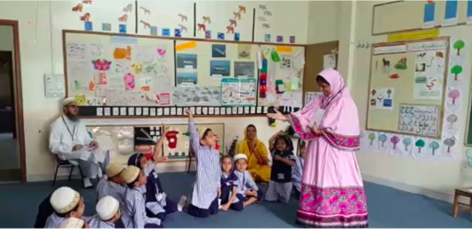
Four centers of Learning/Parenting/Nurturing
MASJID
MANZIL/Home
MUJTAMA/Society
Madrasa/School
www.talabulilm.com
Notes:
Al-Dai al-Ajal Syedna Mohammed Burhanuddin RA defined these four centres of learning for a child.
Parents are facilitators for all of these four centres.
They take their children to Masjid/ Aadat paare che.
Admissions in best available institutes/ Madrasah.
Provide oppurtunities for children to interact with the society.
And…..

Slide 58
Primary Centre of Learning at this age
MANZIL
Your time!
ككهنو وقت spend كرسس ؛ ـ ككهر ما ـ
www.talabulilm.com
Notes:
…. the most essential of these four is Manzil.
A child spends most of his time at home.
So we should also spare enough time for them.

Slide 59
How to Communicate/interact
to convey your idea to Your Child?
Here are 10 Techniques for You
NURTURING
#Communication
www.talabulilm.com
Notes:
How will you communicate and interact to convey your idea to your child?
A few techniques derived from Dawat Hadiyah Kutub.
These slides are designed to enhance your interaction with the audience. You can display each slide and ask the audience about what does the slide says.

Slide 60
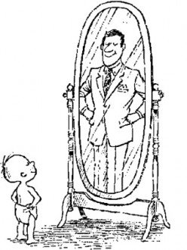
NURTURING
#Communication
www.talabulilm.com
Notes:
What does this image speak of?
Role model.

Slide 61
1) Role
Model
NURTURING
#Communication
www.talabulilm.com
Notes:
Psychologists say that when a child sees that he is becoming like his father/ mother, he feels proud in himself.
Our role model is our Moula TUS.

Slide 62
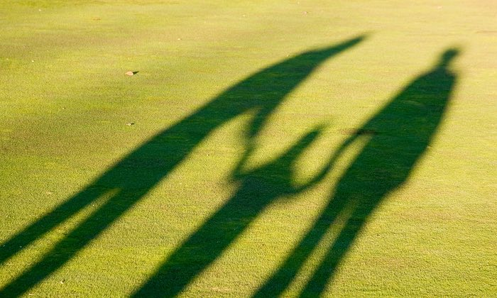
NURTURING
#Communication
www.talabulilm.com
Notes:
What does this image speak of?
Right place and right time.

Slide 63
صحيح وقت انسس صحيح جككه ما وات كروو
NURTURING
2) Appropriate
Place and Time
#Communication
www.talabulilm.com
Notes:
Syedna Taher Saifuddin RA ane Syedna Mohammed Burhanuddin Moula RA ghani waar farmawta ke Jaman na waqt farzando ne toko na.

Slide 64
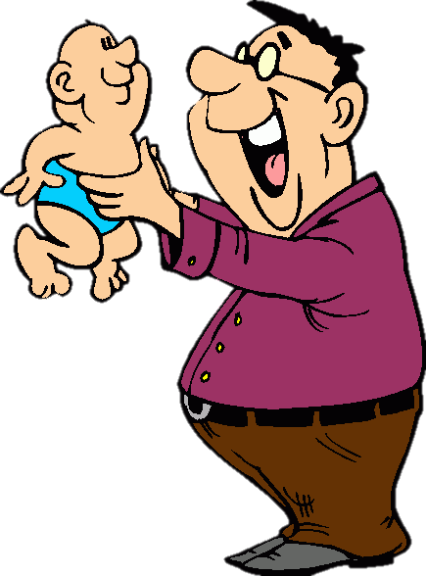
NURTURING
#Communication
www.talabulilm.com
Notes:
What does this image speak of?
Respond towards your childs due.

Slide 65
NURTURING
3) Respond towards
Children’s due
#Communication
www.talabulilm.com
Notes:
Trust and friendship builds in this age.

Slide 66
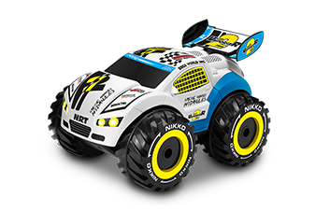
NURTURING
#Communication
www.talabulilm.com
Notes:
Learning through the play way method.

Slide 67
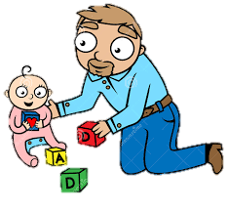
5) Help them do things
NURTURING
#Communication
www.talabulilm.com
Notes:
Artificialism – Toys build an attachment with a child.s
Choose toys wisely.

Slide 68
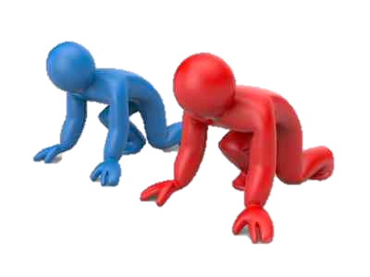
NURTURING
#Communication
www.talabulilm.com
Notes:
Is competition a good thing for your child?

Slide 69
6) Competition
NURTURING
Competition helps kids learn that it is not always the best or the brightest who are successful, but rather those that work hard and stick with it,"
#Communication
www.talabulilm.com
Notes:
Healthy competition to achieve things.
Motivate in failures.

Slide 70
رسول الله ^{صلع} الامامين الحسنين ^{ص ع} نسس خوش خط لكهي نسس لاوانو فرمايو
NURTURING
www.talabulilm.com

Slide 71
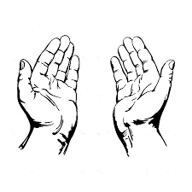
NURTURING
#Communication
www.talabulilm.com

Slide 72
7) Prayers
NURTURING
#Communication
www.talabulilm.com
Notes:
بارك الله فيك
جزاك الله خيرا

Slide 73
"خدا تمنسس ككهني بركة اْثثجو" "خدا تارو بهلو كرسس"
NURTURING
www.talabulilm.com

Slide 74
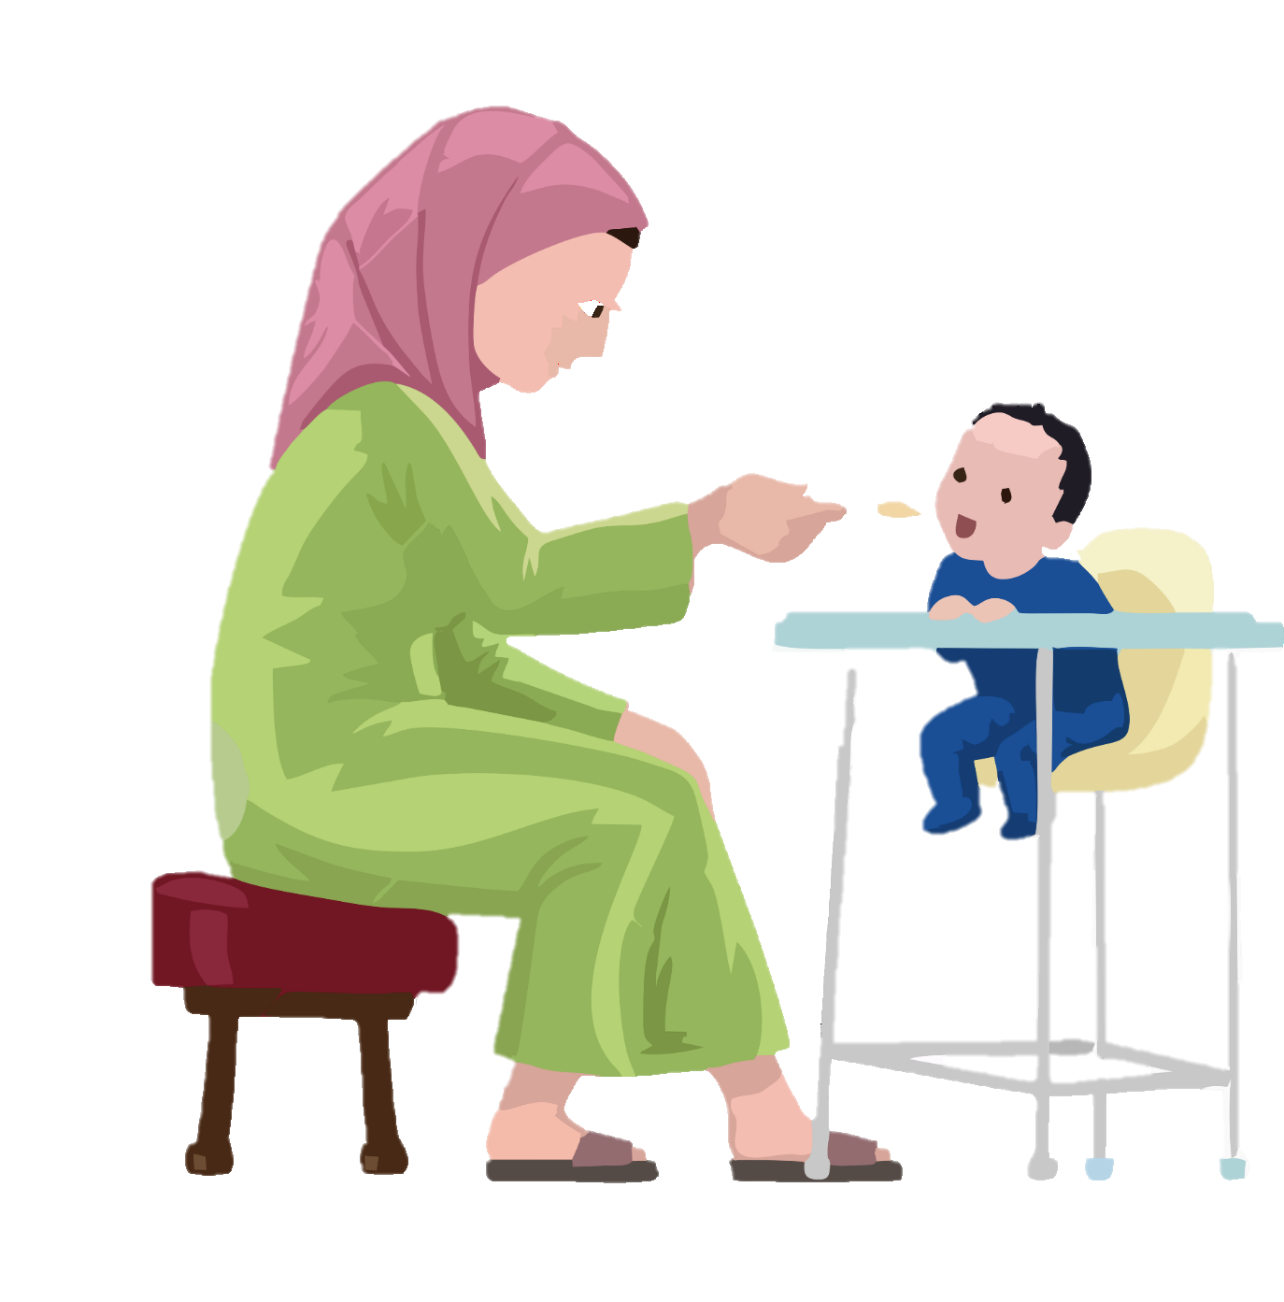
اَ بُنَـيَّ!
NURTURING
#Communication
www.talabulilm.com

Slide 75
8) Addressing
ابني!
NURTURING
#Communication
www.talabulilm.com

Slide 76
امير المؤمنين الامامين الاقدسين نسس
"ابني" فرماوي نسس خطاب كرتا
"اسس ثثيارا عزيزو!"
NURTURING
www.talabulilm.com

Slide 77
NURTURING
#Communication
www.talabulilm.com

Slide 78
9) Stories
NURTURING
#Communication
www.talabulilm.com

Slide 79
رسول الله ^{صلع} انسس مولانا علي ^{ص ع} الامامين الاقدسين نسس انسس اصحاب كرام نسس قصـص سناؤتا
NURTURING
www.talabulilm.com

Slide 80
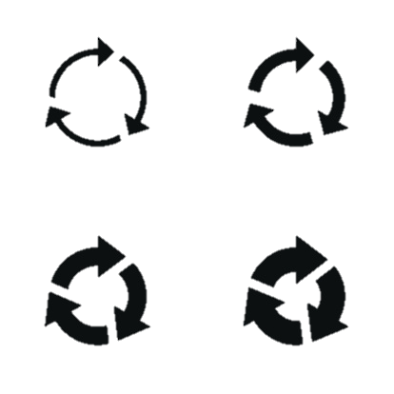
10) Repetition
NURTURING
#Communication
www.talabulilm.com

Slide 81
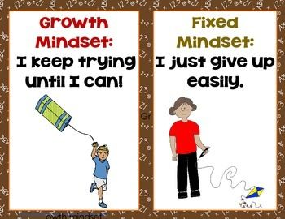
A Key Strategy for communication
NURTURING
www.talabulilm.com

Slide 82
GROWTH MINDSET
NURTURING
Condemn the act , not the child
Praise the act, not the child
#Communication strategy
www.talabulilm.com
Notes:
Refer to the video for a better explanation.

Slide 83
Disciplining and Rewarding
Disciplining vs punishment
NURTURING
www.talabulilm.com
Notes:
Punishing closes all doors for communication.
While punishing you become an executioner.

Slide 84
Punishment creates a final solution with the adult acting as judge, jury and executioner.
Discipline creates dialogue and communication with the adult acting as teacher
NURTURING
www.talabulilm.com

Slide 85
How to Discipline
Correct the idea and then the application.
Permission.
Never show rage.
NURTURING
www.talabulilm.com
Notes:
Disciplining helps the child learn about what went wrong.
The right way to discipline is - Correct the Idea and help them in application.

Slide 86
How to Reward?
Kiss on the forehead
Play with them
Rub on the head
NURTURING
Do not make your child inclined towards greed as a habit
Do not promote instant physical rewards
Promote lofty rewards
www.talabulilm.com

Slide 87
مولى ني امانة
www.talabulilm.com
Notes:
Summarize the whole program and conclude.

Slide 88
www.talabulilm.com

Slide 89
www.talabulilm.com
Notes:
Kalemaat Nooraniyah Sunawa ma awe.
The bayan audio file has been provided in the resources folder.
Copyright of this bayan audio belongs to Aljamea-tus-Saifiyah. No portion of this bayan therefrom may be published, reproduced, disseminated, transmitted, downloaded or replayed in any manner without the express written consent of the copyright holder.
Kindly delete the audio file and all its copies after the seminar.
All rights reserved.

