Slide 1
Business ethics
Jabalpur
January 22, 2022

Slide 2
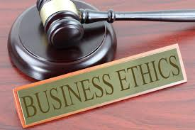
Business ethics – the definition
An ethic is a moral principle or set of moral values held by an individual or a group.
Ethical behaviour is behaviour which is considered to be right and moral.
Business ethics are the values and principles which operate in the world of business. They form the moral framework of the business.

Slide 3
Business ethics – a mumin’s framework
Al Fiqh
Business Norms
Legal Framework
Principles:
Raaziq Allah TA chhe
Maru rizq likhelu chhe
Maru rizq koi bisru nahi lai jai
Koi bisra nu rizq mei nahi lai saku
Moula TUS ni
khushi

Slide 4
Why business ethics
Business ethics help businesses decide what directions/actions are right/wrong or to take/not to take in certain circumstances.
Reputation vs البركة

Slide 9
summation
Spiritual
Religious
Quality – business / processes
Honesty – product / process
Financial – cash
Association – attitude
Rules of the land

