Slide 1
Let’s Begin For A successful Future
CA. Ahmed Ali
+91 7509 520 520
ca.ahmedali@gmail.com

Slide 2
BUSINESS PLANNING
PLAN TO SUCCESS
CA. Ahmed Ali
+91 7509 520 520
ca.ahmedali@gmail.com

Slide 3
Aqa Moula TUS Farmave che..

Slide 4
“The reason most people never reach their goals is that they don’t define them.”
― Denis Waitley, writer and motivational speaker
Notes:
Winners can tell you where they are going, what they plan to do along the way, and who will be sharing the adventure with them.

Slide 5
Today’s Agenda
What is Business Planning?
Reason why you need a Plan?
Why Businesses’ Fail?

Slide 6
Go to www.menti.com
use the code 52 01 77 78
How Many of You have Prepared the Business Plan for their Business

Slide 7
Business Planning
1
What is Business Planning?

Slide 8
Business Planning
A business plan is a WRITTEN DOCUMENT that describes in detail how a business is going to achieve its goals.
A business plan lays out a written plan from a Marketing, Financial and Operational viewpoint..

Slide 9
Reasons Why You Need a Strong Business Plan
2
Plan your work & work your plan

Slide 10
Reasons Why You Need a Strong Business Plan
To Attract Investors.
To see if Business Ideas works.
To set up Milestones.
To Monitor Business.
To secure Additional funding or determine financial needs.
To Devise Contingency Plans.
To Grow Your Business Faster.

Slide 11
Go to www.menti.com
use the code 52 01 77 78
Why Businesses’ Fail

Slide 12
Why Businesses’ Fail
3

Slide 13
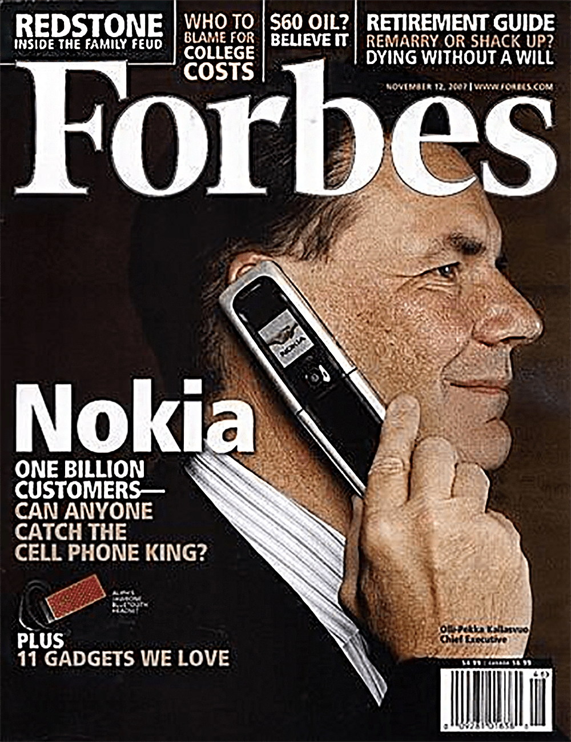
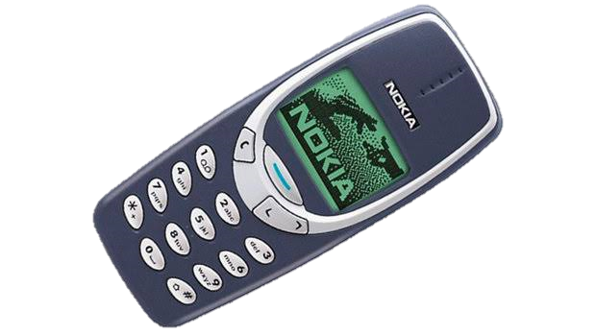
`
Notes:
https://www.youtube.com/watch?v=-eXAkBAZNEg

Slide 14
`
Reasons why Business Fails
Ignore Customer Needs
Inability to Learn
“We didn't do anything wrong, but somehow, We lost ...”
Notes:
https://www.youtube.com/watch?v=-eXAkBAZNEg

Slide 15
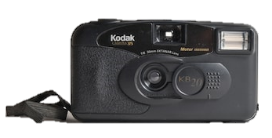
`
Notes:
https://www.youtube.com/watch?v=-eXAkBAZNEg

Slide 16
`
Reasons why Business Fails
Lack of Planning
Focus on Single Product
Poor Management
Notes:
https://www.youtube.com/watch?v=-eXAkBAZNEg

Slide 17
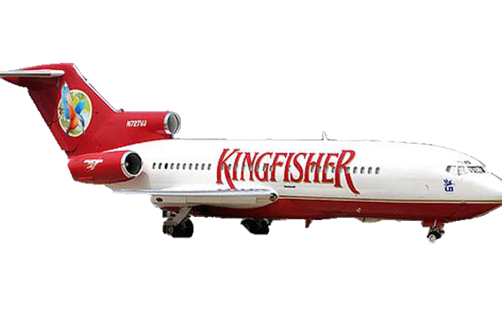
`
Notes:
https://www.youtube.com/watch?v=-eXAkBAZNEg

Slide 18
`
Reasons why Business Fails
Lack of Capital
Personal Use of Business Funds
Poor Management
Over Expansion
Notes:
https://www.youtube.com/watch?v=-eXAkBAZNEg

Slide 19
Reasons Why Business Fails
Failure to understand your Market and Customers.
Failure to understand and Communicate what you are selling.
Inadequate Financing.
Reactive Attitudes.
Overdependence on a Single Customer.
No Customer strategy.
Not knowing when to say “No”.
Poor Management.
Poor Planning.

Slide 20
Fundamentals of Business Plan
5
Plan TODAY & Revise Tomorrow

Slide 21
Fundamentals of Business Plan
It’s the planning, not just the plan. That’s critical and we all see it now as sudden unexpected changes — the black swan — blow our plans up. No worry, business plans are always wrong, so it’s always been the planning process that makes them worthwhile. Planning means plan and review, revise, and correct, and review and revise and correct again. Watch how the assumptions change. This is absolutely fundamental to planning.
Shorten the cycle. You’re using planning to steer your business now, and the road is curvy and bumpy and unpredictable, so you pay closer attention and concentrate more carefully. Review your numbers frequently. Watch for changes, surprises, and the unexpected. It’s about early warnings. Watch the short-term closely. Use your planning as an early warning system
Sharpen the focus. Narrow it down. Make sure you’re close to your best customers. Sharpen the marketing message, and review where it’s going and how. Avoid wasted resources.

Slide 22
Fundamentals of Business Plan contd…
Watch the cash flow. As the kids would say, “no duh.” But even if it’s obvious, I can’t leave it out of the fundamentals. Please remember that profits aren’t cash, and watch for changes in the cash cycle, like your business customers waiting longer to pay their bills. A business-to-business company needs extra financing worth a month of sales for every 30 days longer that customers hold off their payments.
Watch the metrics. Remember, you’re looking for early warning systems. Obviously sales costs, and expenses are metrics, but measure wherever you can, and watch for changes. Phone calls in and out? Time per call? Presentations? Inquiries? Metrics work for early warning.
Communicate better than ever. Do you have something to say to your customers, or your employees, or vendors? Stay close. If you have to pay your bills more slowly than you’d like, make sure your vendors know they are still going to get paid. If you have to focus more efforts on your best customers, make sure they know it. Don’t let people guess wrong about what you’re doing or what you’re thinking.
Your business plan is always wrong, but vital. Refer point number 1.
Your business plan is never done. Refer point number 1.

Slide 23
https://tijaaratraabehah.org/

Slide 24
Content of Business Plan
5
Good Plan TODAY is better than a Perfect Plan Tomorrow

Slide 25
Content of Business Plan
Business TimeLine
Executive Summary
Mission Statement
Financial Planning
Company Background
Business Plan
Operation Analysis
Product Description
SWOT Analysis
Marketing Plan
Competitive Analysis

Slide 26
Executive Summary
Keep It Brief

Slide 27
Market Research
Even Reliance need a Market Research.
What is Market Research? - Market research is the process of gathering information about your potential customers.
Why to do Market Research? - If you don’t understand your customer, you don’t know how you can help solve their problems
Marketing Research Necessary? – No Study would lead you targeting wrong customer at wrong timing.
How to Do a Market Research? -
Notes:
For any type of business, there's a real need for market research. This is especially the case for small businesses, where the first few months can prove to be precarious. New businesses need sales and customers as soon as possible, and market research can ensure that those sales and customers don’t stop coming.

Slide 28
Market Research
Keep It Simple
Without a viable market for your product or service, your business is doomed.
Consider the following factors when segmenting your audience:
Demographic - What age group? What gender? What is your Target Market?
Talk – Talk to your Potential customers.
Size- Find out how big your Market is?
Write it – Document your findings.

Slide 29
Competitor Analysis
Even Amitabh Bachchan have a Competitor.
Who is My Competitor? – All those people who are solving same problem you are solving are your Competitor (no matter Small or Big, Direct or Indirect)
Why to do Competitor Analysis? - If you don’t understand how your Competitor serve his customer, you don’t know how to improve.
Competitor Analysis Necessary? – To understand the STRENGTHS and WEAKNESSES of the your competitors.
How to Do a Competitor Analysis ? -

Slide 30
Competitor Analysis
Keep It Fair
Ask yourself these questions:
Identify your competitors’ – Direct/Indirect or Big/Small.
Look for competitors’ Sales tactics and results.
Determine your competitors’ market position.
Look at your competitors’ market & pricing strategies.
Perform a competitors’ SWOT analysis.

Slide 31
Financial Plan
Even Amazon & Apple do their Financial Analysis.
What is Financial Plan? – An overview of your current business financials and projections for growth.
Why to do Financial Analysis? – To understand how your business is growing & what how much fund you need and when.
Financial Analysis Necessary? – It helps you to set a realistic expectations regarding the success of your business and can take crucial business decisions.
How to Do a Financial Analysis ? -

Slide 32
Financial Analysis
Keep It Update
When it comes to financial matters, your business plan should include details about:
Assumptions - Pick reasonable assumptions. You don't need to spend much time justifying your assumptions unless they are critical to the company's success.
Key Financial Indicators and Financial Ratios – an Executive summary to the most important information for measuring the performance of the entity.
Cash Flow Projection – the other plans tell you the story, cash flow tell whether it is going to work or not?
Projected Income Statements and Balance Sheets – this will determine when & how much cash is needed and is investor ready to fund in.
Break-even Analysis or Cost-volume-profit Analysis – it will help you make a crucial decision whether you wanna sell or take a step back.

Slide 33
Executive Summary
Keep It Brief
Crucial components of an Executive Summary:
Business Model - What is your product or service? How will you make money?
Target Market - Who will benefit from this product or service?
Business Opportunity - Why do consumers need your product or service?
Marketing Strategy - How will these consumers learn more about your product or service?
Competition - What other companies are competing for market share?
Goals - How will your startup transform the marketplace with this product or service?

Slide 34
Reliance Industries Limited is engaged in refining, including manufacturing of refined petroleum products, and petrochemicals, including manufacturing of basic chemicals, fertilizers and nitrogen compounds, plastic and synthetic rubber in primary forms
Kingfisher Airlines Ltd is the largest charter aviation company in India. Their principal activity is to provide commercial passenger airline and private helicopter and airplane chartering services in India.
Bigbasket is the largest online grocery supermarket in India. ... Bigbasket offers groceries and food supplies in various categories such as fruits & vegetables, food grains, oil, masalas, bakery items, beverages, branded foods, personal care products, household supplies, eggs, meat, fish, etc.
Flipkart is a company providing an e-commerce marketplace offering consumer products including books, media, consumer electronics, lifestyle, and personal and healthcare products. The company provides services like cash on delivery and 30-day replacement policy.

Slide 35
Company Summary
Keep It Hard
``
The company summary or headline statement should do the following:
Give people a Brief Overview of what your company does.
Communicate the value you offer.
Highlight the opportunity in the market.
<Your company>
is a <type of business>
who sells <product or service>
to <target customer>,
who needs <solution>,
but doesn’t get it from <competition>.

Slide 36
Company Summary
Keep It Hard
The company summary or headline statement should do the following:
Give people a Brief Overview of what your company does.
Communicate the value you offer.
Highlight the opportunity in the market.
``
Flipkart is a company providing an e-commerce marketplace offering consumer products including books, media, consumer electronics, lifestyle, and personal and healthcare products. The company provides services like cash on delivery and 30-day replacement policy.
<Your company>
is a <type of business>
who sells <product or service>
to <target customer>,
who needs <solution>,
but doesn’t get it from <competition>.

Slide 37
SWOT Analysis
6
All You Need is a Plan & Half the milestone is achieved..

Slide 38
Go to www.menti.com
use the code 52 01 77 78
How many of you have done SWOT Analysis

Slide 41
SWOT Analysis
DO IT YOURSELF
6
All You Need is a Plan & Half the milestone is achieved..

Slide 42
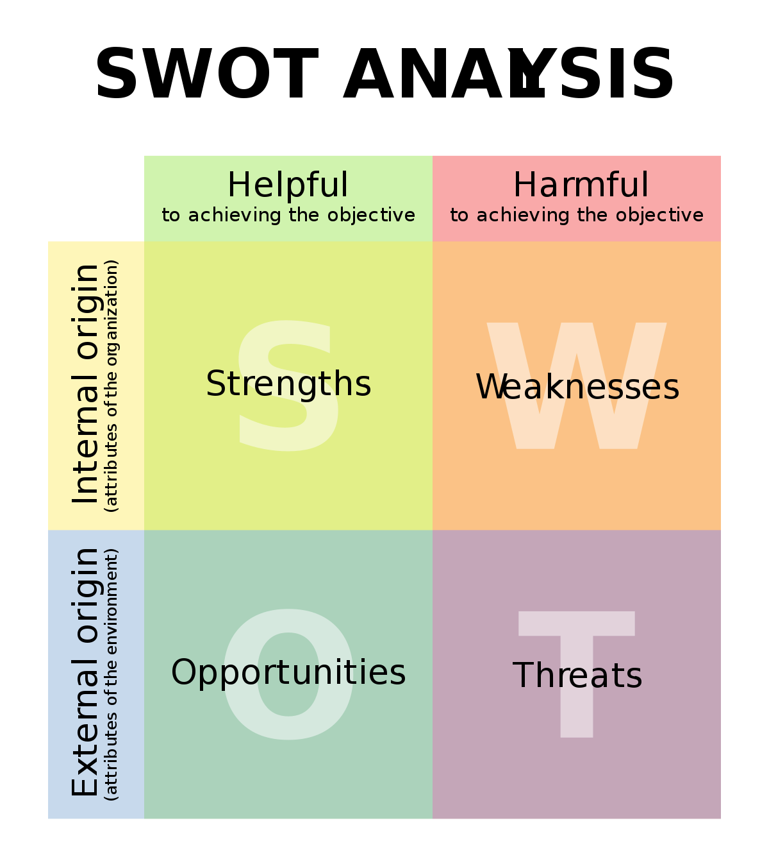

Slide 43
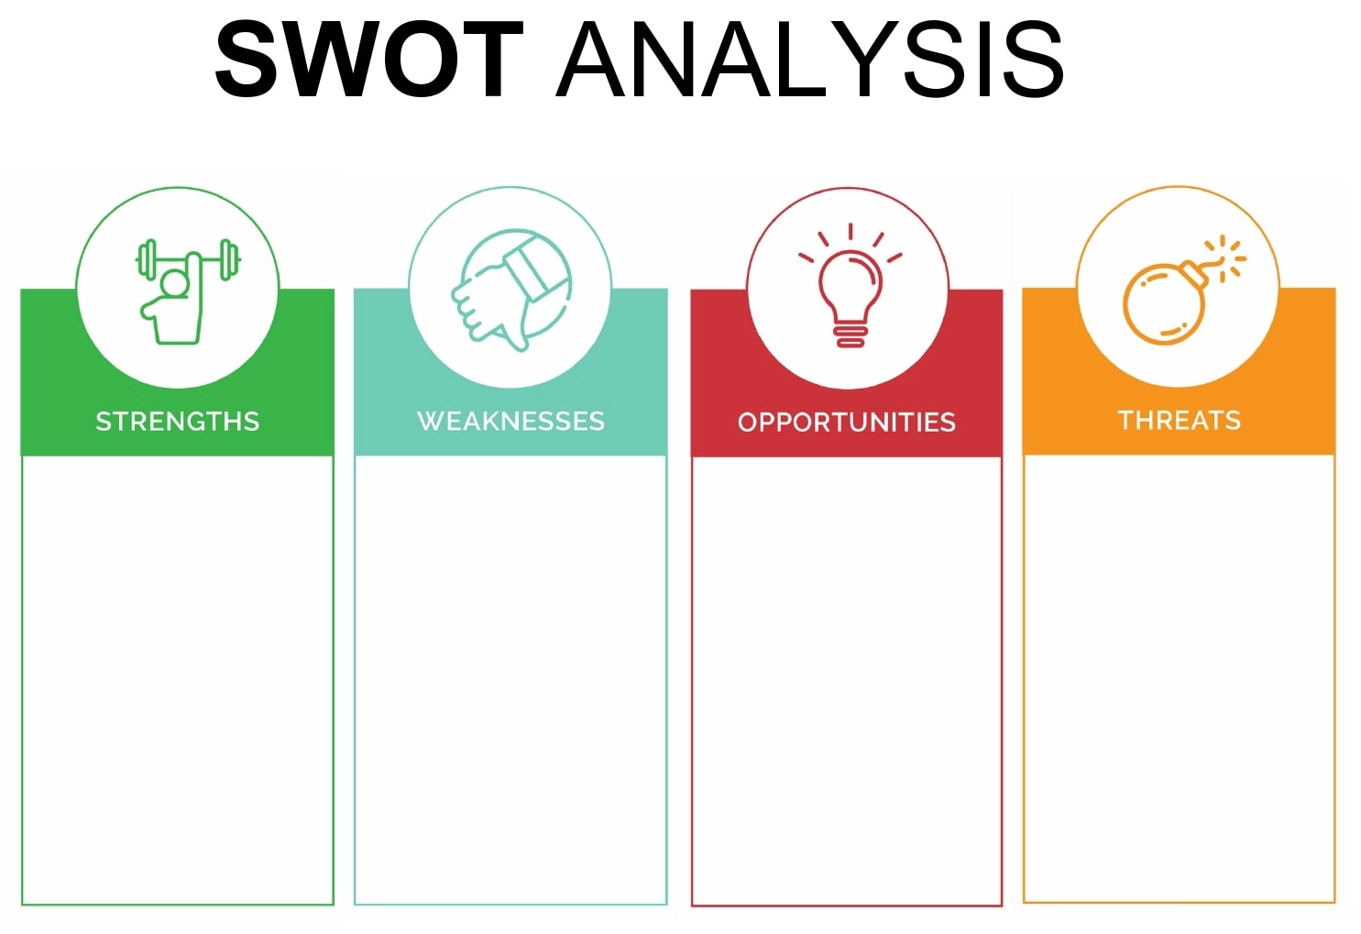

Slide 44
Today’s Key Takeaway
Tomorrow Belongs to those who prepare it TODAY

Slide 45
Today’s Key Takeaway
Business Plans are Critical for the success of a company.
Different businesses require different types of Business Plans.
All Business Plans have some Essential Sections that explain the core aspects of the company.
SWOT Analysis is MUST & Necessary.
Need to Understand Technology Suitable for my Business.

Slide 46
SCAN THE CODE

Slide 47
Thanks!
Any questions ?
You can find me at
+91 7509 520 520
ca.ahmedali@gmail.com
@caahmedali
Expect the unExpected
….Be Prepared

