Slide 1
UPLIFTMENT DEPARTMENT
NUTRITION UPLIFTMENT
Lifestyle & Dietary Modification Guidelines

Slide 2
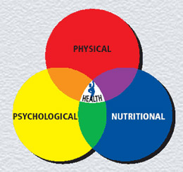
GUIDELINE 1: Mindful Eating Good Nutrition …. …. is associated with
Psychological Well-being
Quality of Work
Social Connectedness

Slide 3
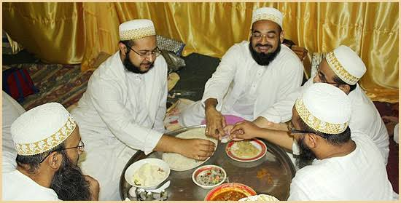
Be Grateful Always start with بسم الله and end withالحمد لله
How you eat is more important.
Be grateful not fearful of food.
Eat your food slowly. Chew it well.
Eat till your stomach is 80% full.
Eat using all 5 senses.
Make mealtimes pleasant and happy.
Eat together as a family or community.

Slide 4
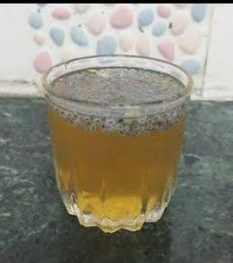
GUIDELINE 2: Hydration
Drink at least 8-10 glasses daily.
Drink your water slowly sipping it throughout the day.
Take adequate fluids & fruits to keep yourself hydrated.
Water recharges the body
It detoxifies and cleanses the body
Hydration drinks list:
Water
Golpani
Fruit juices
Lime water
Honey water
Buttermilk

Slide 5
GUIDELINE 3: Honey & Kilonji
A teaspoon of honey with 7 seeds of kilonji daily cures our body of all ailments.
Energizes our brain and body
Enhances memory
Boosts immunity
High in antioxidants & nutrients

Slide 6
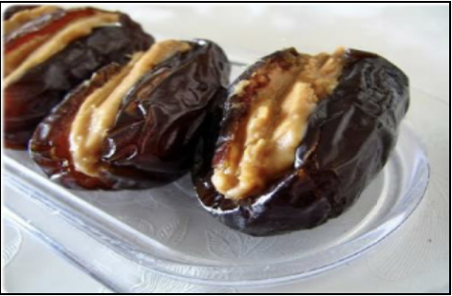
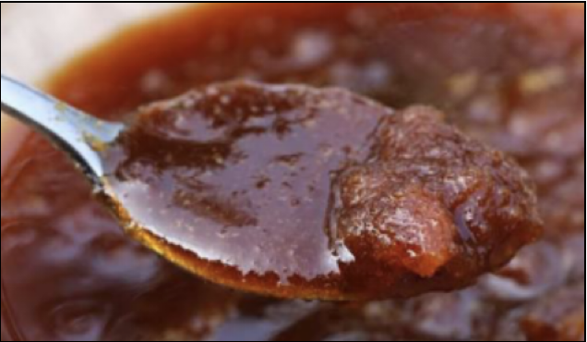
Dates
Take 1-2 dates daily to avoid anaemia.
Dates contain the right balance of sweetness and fibre that provides sustained energy.
Combine dates with citrus fruits to increase its benefit.

Slide 7
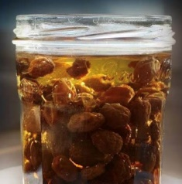
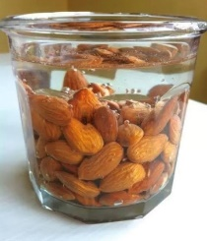
GUIDELINE 4: Healthy Start
Raisins soaked overnight
Banana/ Seasonal Fruit
Soaked Almonds
Can choose to have two or three of these options
If you have insulin resistance or diabetes pick soaked almonds
Take this meal within 30 minutes of waking up

Slide 8
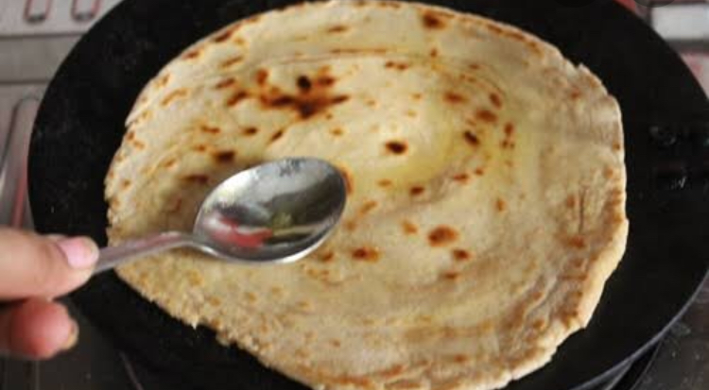
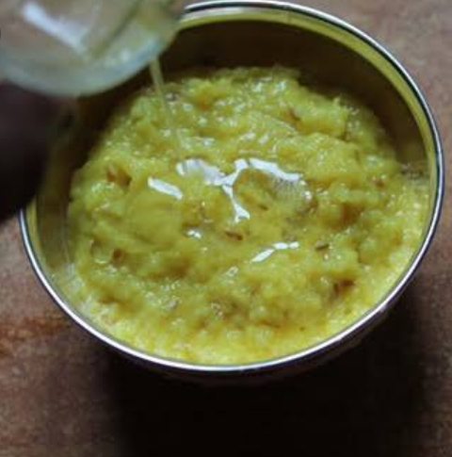
GUIDELINE 5: Ghee Is Good
Add a teaspoon of ghee
Ghee provides essential fats, improves digestion & maintains healthy body fat.
In controlled amount ghee aids in both weight gain & weight loss.
How to indulge in your diet?
You can apply on your roti or paratha
You can add it in your rice
You can make raab out of it

Slide 9
GUIDELINE 6: An Egg a Day
Daily consumption of egg is essential to complete our daily requirements of nutrients.
It can be seen as a nutritional supplement that provides essential fats, proteins, vitamins & minerals.
It aids in growth, repair, recovery from illness and boosts immunity.

Slide 10
An Egg a Day!
2 BISCUITS/ BREAD
100 KCALS
EMPTY CALORIES
1 Egg
70 kcals
Provides essential nutrients

Slide 11
GUIDELINE 7: Daily Dairy
Include milk & milk products such as curd, paneer, cheese, buttermilk, skim milk powder two to three times a day to fulfil your daily requirements of calcium & protein.
It is essential for bone & teeth health.
It helps the body grow, repair & recover.

Slide 13
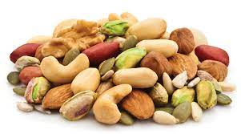
GUIDELINE 8: Nuts & Seeds Nuts & seeds provide essential fats & proteins. They contain healthy fats that are beneficial to the heart, brain & immune system

Slide 14
GUIDELINE 9: Rainbow Colours
Fruits & Vegetables provide vitamins, minerals & fibre for optimum body functions & helps fight infections
The rainbow colours provide different antioxidants & nutrients that help keep you active, healthy & disease free
Add two to three colours to your daily meal

Slide 15
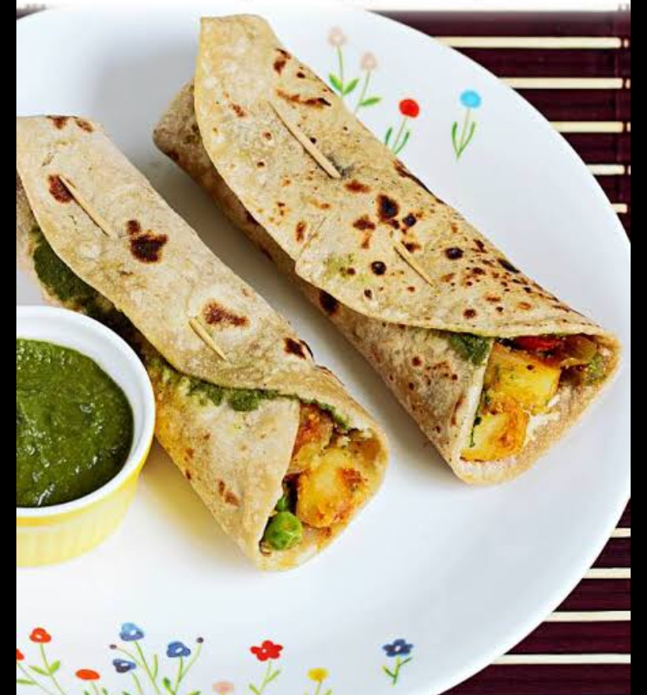
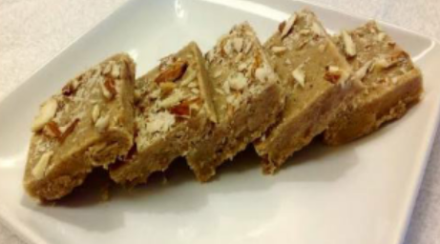
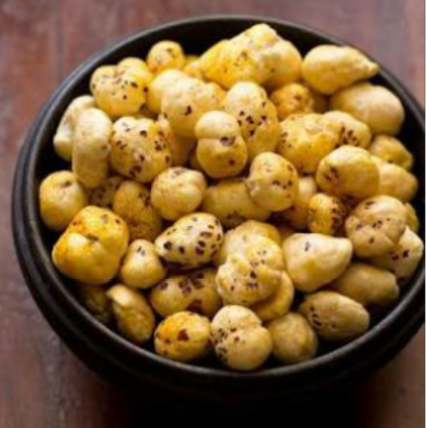
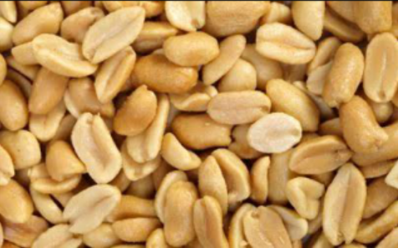
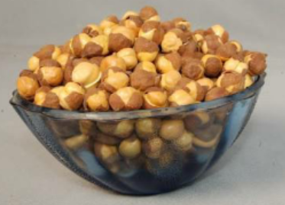
GUIDELINE 10: Snack time
A wholesome & healthy evening snack helps the body to be active during the 2nd half of the day & prevents over eating during dinner
Keep it balanced by including cereals, dairy & fruits. Eg. Corn chat, golpapdi, wraps, upma, roasted makhana, peanuts, chana, popcorn with milk products & fruits

Slide 16
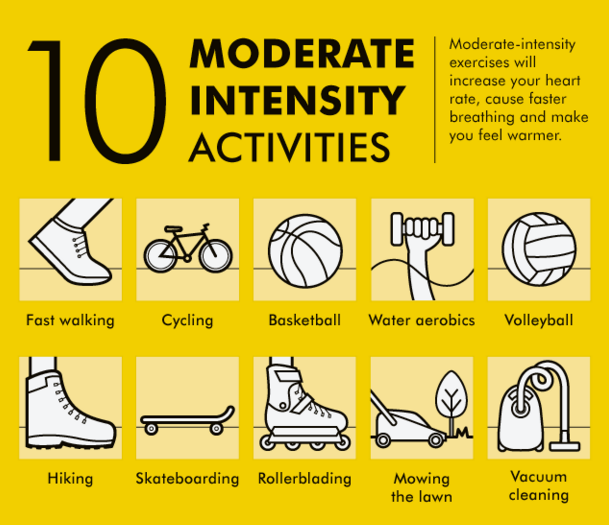
GUIDELINE 11: Be Active
Moderate Exercise + Active Lifestyle
Brisk Walking , Yoga, Strength Training
Daily Chores, Khidmat
Avoid Long Hours of Sitting

Slide 17
GUIDELINE 12: Sound Sleep
Good sleep is the essence of a healthy mind and body.
Timely and sound sleep helps the body heal and repair.
It helps organise information and solve problems.
Adequate undisturbed sleep keeps hormones & body functions balanced & regulates normal weight & body functions.

Slide 18
و طول الهي عمر سيف لدينك الذي حاز من غر الشؤون افانينا

